Slide 1
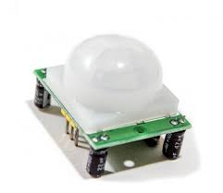
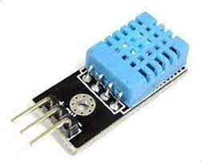
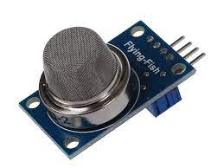
Arduino Session Seven
Home Security System, keypad-PIR sensor
LAB safety system, gas sensor, temperature sensor

Slide 2
Home Security System
Use PIR sensor to detect any warm body movement, and then raise Alarm
Stop alarm based on input Password
Use LCD display Screen to display the inputted password

Slide 3
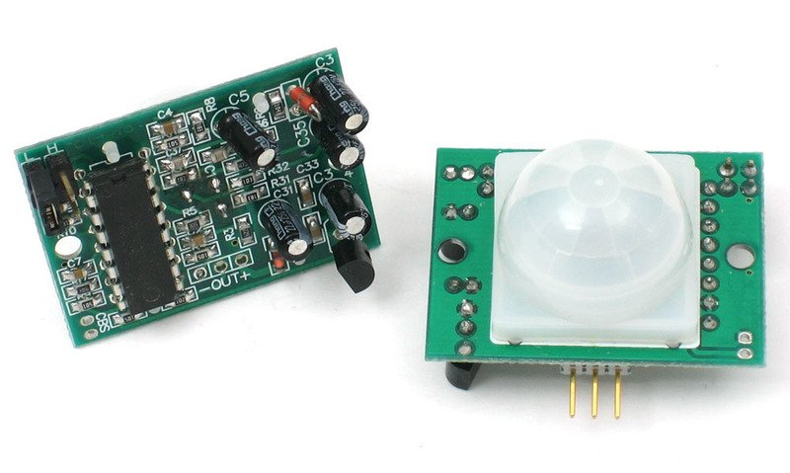
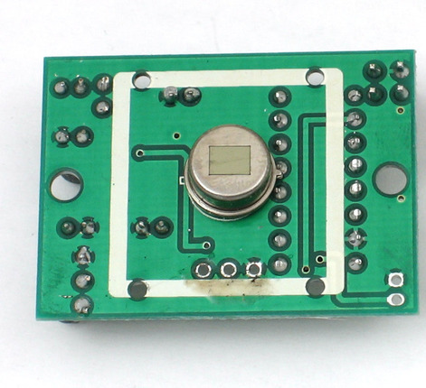
How PIR sensor works
When a human (basically) enters the PIR sensor range the pyroelectric sensor will generate a voltage difference that the IC process and send HIGH/LOW based on difference level

Slide 4
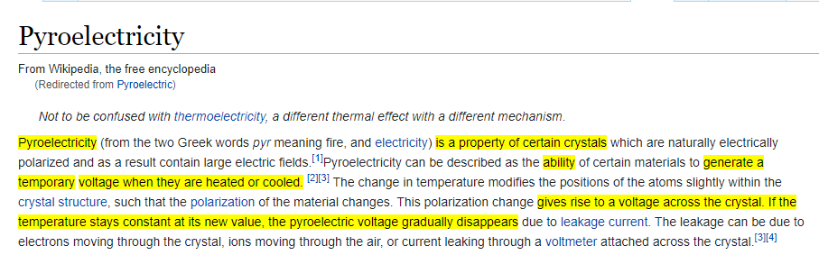
What is inside Passive Infra Red sensor
pyroelectric sensor

Slide 5
What is inside PIR sensor
BISS0001 Micro Power PIR Motion Detector IC (datasheet available)
Supporting circuitry based on IC and pyroelectric sensor (resistor, diodes, coils, …)

Slide 6
How to interface PIR sensor
Open tinkercad.com

Slide 7
Use Keypad to take input
Create a string of input
If user input any number 0 to 9
If user pressed A clear the string
If user pressed B clear one number
If user pressed C process the string
Ignore other characters

Slide 8
Use Keypad to take input
Open tinkercad.com

Slide 9
LAB safety system

Slide 10
Types of Direct Interface Sensor
 | No Processing Required | Processing Required
Digital Sensor | Pushbutton | Ultrasonic Sensor
Analog Sensor | Potentiometer | MQ2 Gas Sensor

Slide 11
LAB safety system - Gas Sensor Overview
Types of Gas Sensors
Chemical Gas Sensor
Optical Gas Sensor
Acoustic Gas Sensor
Electrical Sensor

Slide 12
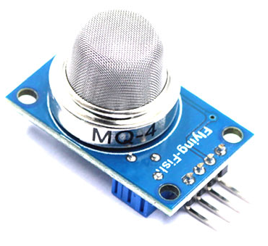
LAB safety system – MQ2 Gas Sensor

Slide 13
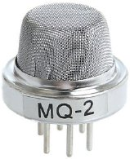
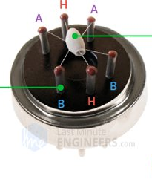
LAB safety system – How MQ2 Gas Sensor Works

Slide 14
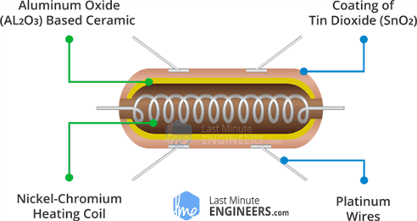
LAB safety system – How MQ2 Gas Sensor Works

Slide 15
LAB safety system – MQ2 Gas Sensor Pinout
Search online for gas sensor pinout, share with us what you find
Connect the gas sensor to the Arduino, and make a simple testing sketch to read the analog input of the gas sensor and display it on the serial monitor

Slide 16
LAB safety system – MQ2 Gas Sensor Datasheet
I will send the link of the datasheet on zoom chat

Slide 17
LAB safety system – MQ2 Gas Sensor Tinkercad
Open tinkercad.com

Slide 18
LAB safety system – Gas Concentration
Search for how to use gas sensor with Arduino, share with us what you find, DO NOT implement the code you find

Slide 19
LAB safety system – Gas Concentration
we will find the specific equation from datasheet

Slide 20
LAB safety system – Gas Concentration
we will find the specific equation from datasheet

Slide 21
LAB safety system - Gas Sensor
Propane is considered safely breathable if ppm
is below 500 up to 8h of exposure
1000 up to 10 min of exposure
Thus we want to get 250 ppm
Propane is considered dangerously flammable if between 2100 ppm and below 9500 ppm

Slide 22
LAB safety system - Temperature Sensor
Search online for temperature sensor
(check tinkercad for it’s part name)
Send me pictures of implementation and code, over WhatsApp or zoom chat, maximum time: 25min

